Slide 1
TYPES OF SHARES
A. RAMEEZA
Assistant Professor of Commerce
Jamal Mohamed College
(Autonomous)
Trichy-20.

Slide 2

SHARES
share is a percentage of ownership in a company or a financial asset. Investors who hold shares of any company are known as shareholders.

Slide 3
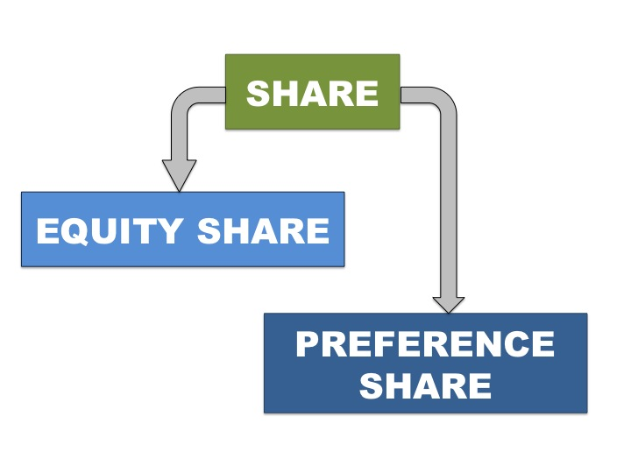
Types of Shares

Slide 4

Equity Shares
The equity shares are those shares on which the dividend is paid after the dividend on fixed rate has been paid on preference shares.

Slide 5

Preference shares
Preference shares are those shares which carry with them preferential rights for their holders, i.e, preferential right as to fixed rate of dividend & as to repayment of capital at the time of winding up of the Company.

Slide 6
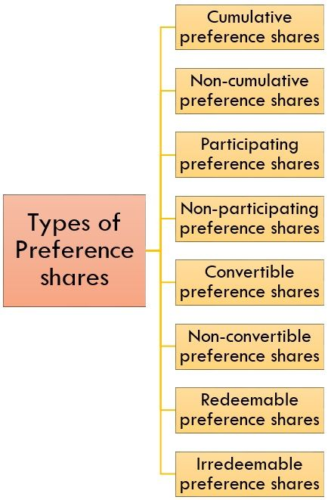
Types of Preference Shares

Slide 7
Cumulative Preference Shares
Cumulative Preference Shares are those Preference Shares which carry right to receive arrears of dividend before the company makes payment to Equity Shareholders.

Slide 8
Non-Cumulative Preference Shares
Non-Cumulative Preference shares do not carry any rights for receiving arrears of the dividend

Slide 9
Participating preference shares
These shareholders enjoy fixed dividends and also share a part of the surplus profit of the company along with equity shareholders.

Slide 10
Non-participating preference shares
These shares do not yield the shareholders the additional option of earning dividends from the surplus profits earned by the company. In this case, the shareholders receive only the fixed dividend.

Slide 11
Convertible Preference Shares
Those Preference Shares which have the right to be converted into Equity Shares are called Convertible Preference Shares.

Slide 12
Non-convertible Preference Shares
Non-Convertible Preference Shares do not have the right to be converted into Equity Shares.

Slide 13
Redeemable Preference Shares
Redeemable preference shares are shares that can be repurchased or redeemed by the issuing company at a fixed rate and date.

Slide 14
Non-redeemable Preference Shares
Non-redeemable preference shares are those shares that cannot be redeemed during the entire lifetime of the company. In other words, these shares can only be redeemed at the time of winding up of the company.

Slide 15


